Slide 1








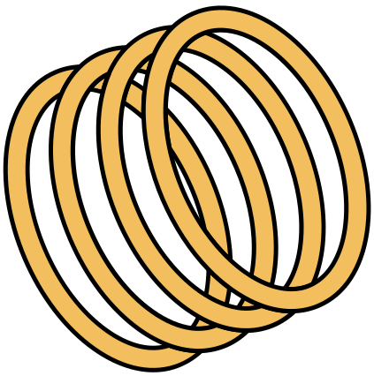

Faculty Mentor :- Dr.Nirupama MP

Slide 2





INTRODUCTION TO PROJECT
1
Our project is based on creating a touchless doorbell, which in this time of the covid pandemic is very necessary, it utilizes the Arduino UNO,Relay module and many more components to be assembled.
2
Whenever a person arrives at our home, so instead of pressing the bell, the person can raise hand at around 10cm so that the ultrasonic sensor can sense the presence of a person and speaker will ring automatically without any touch to the bell.

Slide 3


PROBLEM DEFINITION AND OBJECTIVE
1.
2.
3.
During this covid situation, we are taking a lot of precautions to save ourselves from coronavirus, but there are high chances of carelessness which might lead to bad consequences .Also, due to the new variant omicron the situations are getting worse.
So, we planned on making this contactless doorbell. The main objective behind this project is to reduce the further spread of the corona virus, as when someone enters our home the first thing that he/she encounters is the doorbell, and it's not always possible to sanitise everything around us.
So, we decided to transform our traditional bell into a contactless bell, which eliminates the contact and hence reduces the chances of further spread

Slide 4


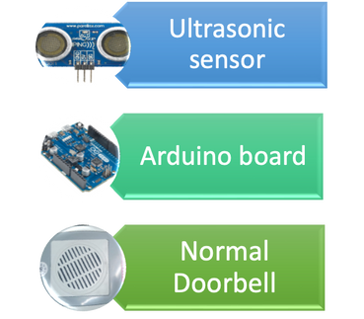
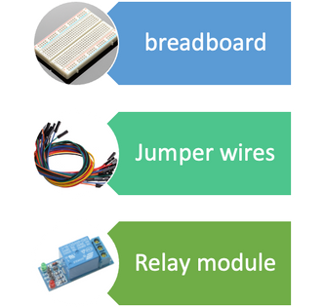




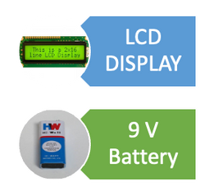

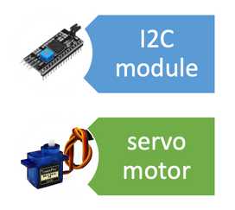

Hardware and software components used
HARDWARES
SOFTWARES
•Tinkercad (for simulation)
•C++ (for programming)
•Visual studio code
•Arduino IDE

Slide 5








BLOCK DIAGRAM
servo motor
16 X 2 LCD DISPLAY
Signal
Signal
AC
SUPPLY
Relay Module
Normal
Doorbell
Signal
AmpSignal
Power
Arduino
UNO
Power
Signal
Ultrasonic sensor
10 cm

Slide 6
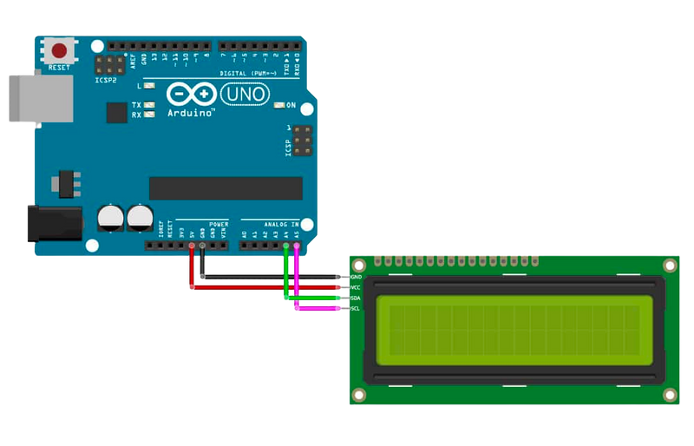
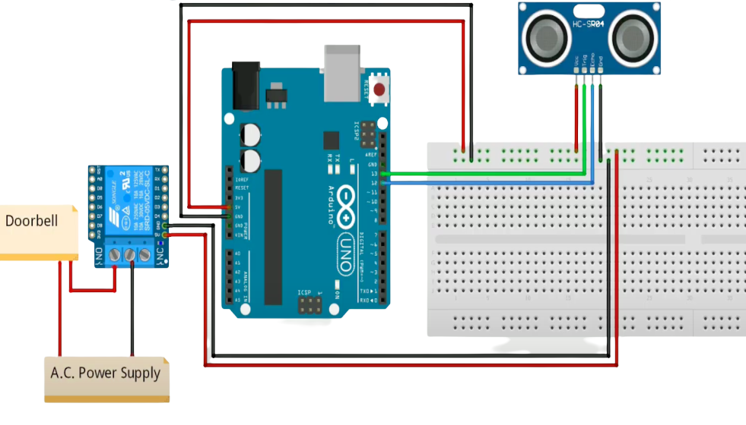
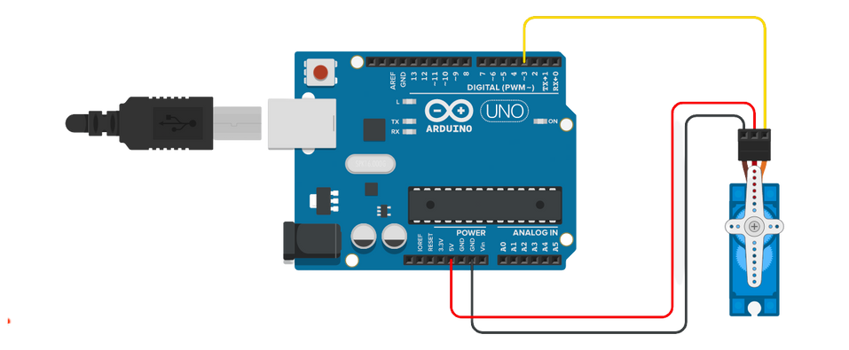
CIRCUIT DIAGRAM

Slide 7
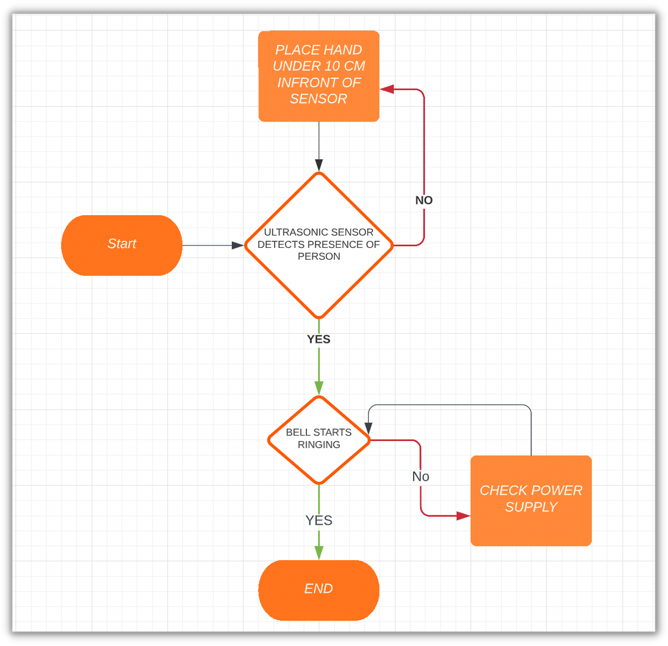
FLOW CHART

Slide 8
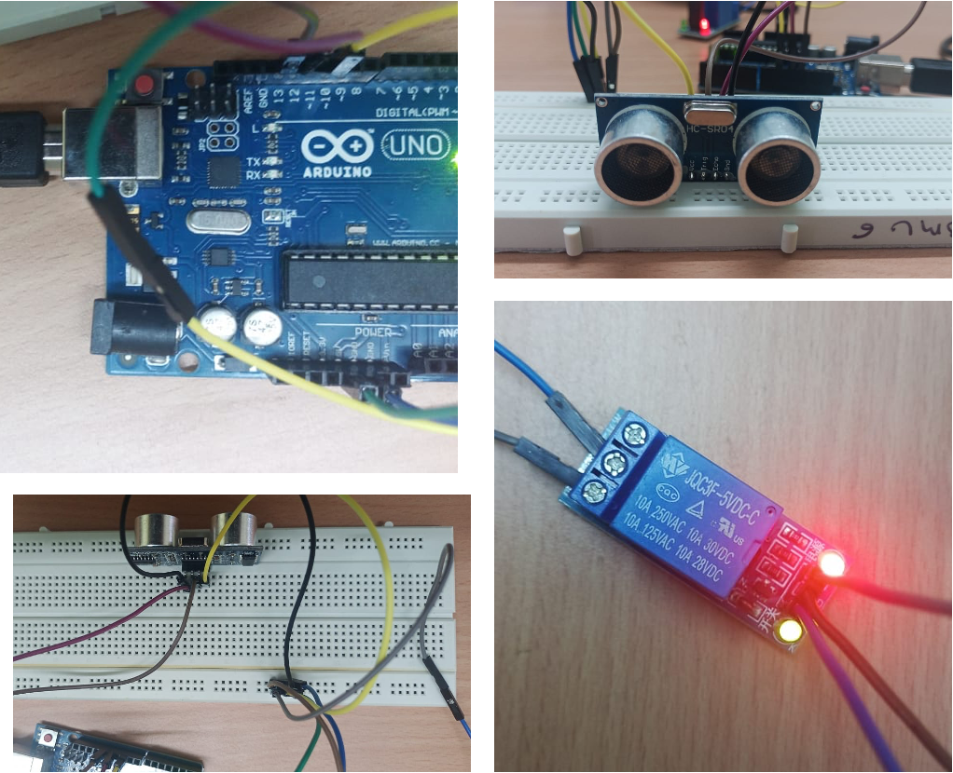
HARDWARE ASSEMBLY

Slide 9


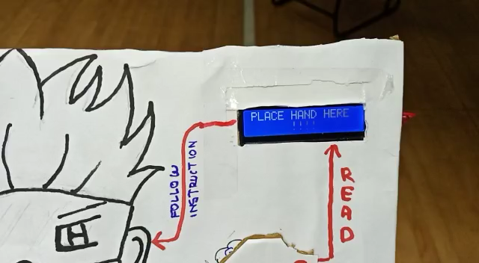



FINAL SOLID WORKING MODEL OF PROJECT

Slide 10
Contribution of each member
MEMBER
CONTRIBUTION
Somik Bansal
Dasariraju Deepak
Milind Jain
Dharmanshu Singh
Research and information collection
Hardware working
Hardware working as well
Coding

Slide 11
REFERENCES
1.) https://www.youtube.com/
2.) https://www.geeksforgeeks.org/
3.) https://codewithharry.com/videos/cpp-tutorials-in-hindi-1
4.) www.wikipedia.com
5.) https://github.com/

Slide 12







THANK
YOU!
"NECESSITY OF NON CONTACT DEVICES IN THIS TIME OF COVID PANDEMIC, IS WHAT MADE THIS PROJECT POSSIBLE"

